Slide 1
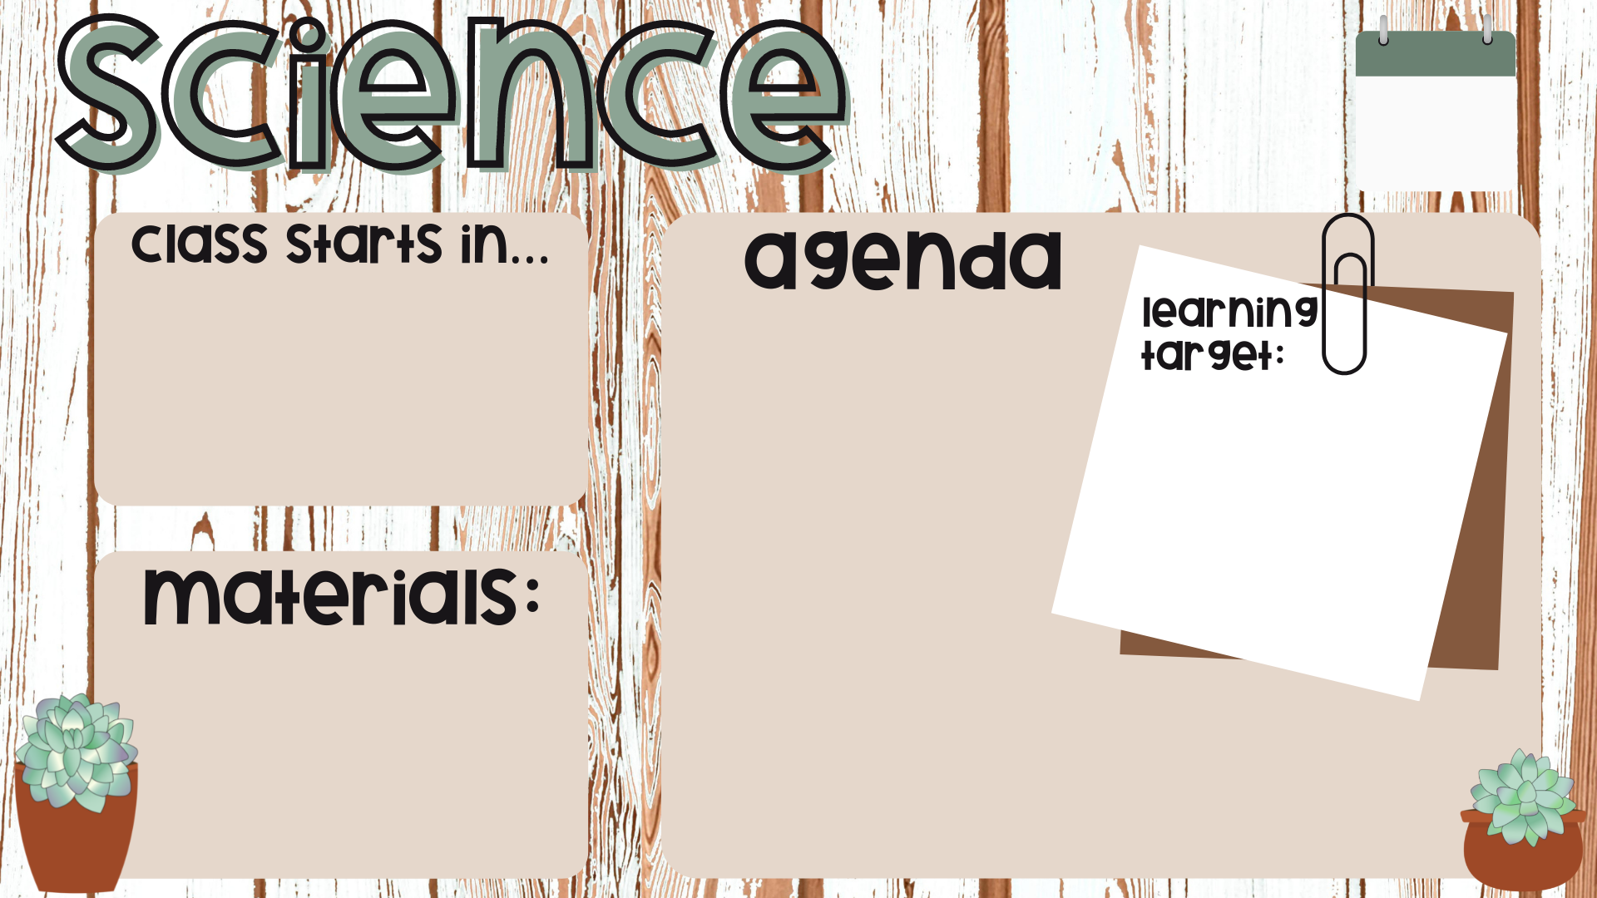

FEB
2
Genetic Bingo
Show me what you know
Probability of human traits
Identify their physical traits
Explain why some traits are more common than others (dominant vs. recessive)
Identify their current knowledge about Genetics
Folder
Exercise Book
Pen

Slide 2
Do not delete this slide.
This slide is designed so that you can copy the prompt box you need and insert it into your slides.
This slide is hidden and will not be included when presenting your lesson.
TRACK WITH ME
VOCABULARY
1 -
HINT
Students, remember….
CHECK FOR UNDERSTANDING
READ WITH ME
TEACHER CUE
MAKE THE CONNECTION
Students, you already know….
EXTENSION
GESTURE WITH ME

Slide 3
Repeat the opposite word/phrase.
WORD
DEFINITION

Slide 4
We are learning about: Genetics
TRACK WITH ME
READ WITH ME
Identify their genetic traits
Explain why some traits are more common than others (dominant vs. recessive)
Explain their current knowledge about Genetics
DECLARE THE OBJECTIVE
Read the learning objective to your partner.
Notes:
Learning Objectives contain concepts (nouns, big ideas), skills (verbs, measurable behaviours) and sometimes context (restricting or targeting conditions).
●Example: Students will be able to describe the concept of density and apply it to floating and sinking.
●
Success criteria are specific measurable outcomes that if met mean that the student has met the learning objective.
Examples:
•Students will be able to compare densities of substances using mass and volume.
•Students will be able to identify whether a solid or liquid will float or sink in a liquid based on their densities.

Slide 5
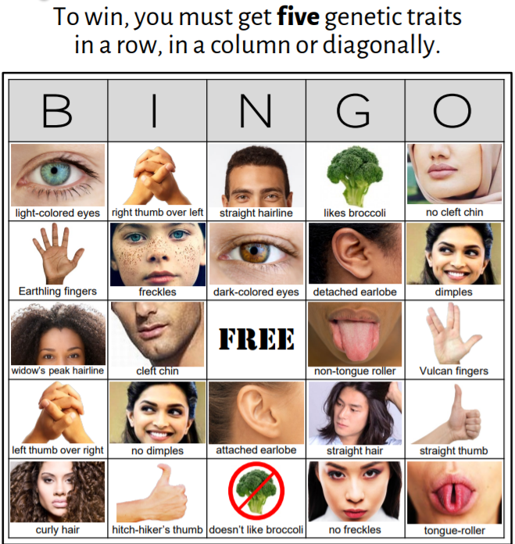
Identify their genetic traits
Genetics Bingo Activity
When Ms calls out a genetic trait, only put an X through it if it is true for you!

Slide 6
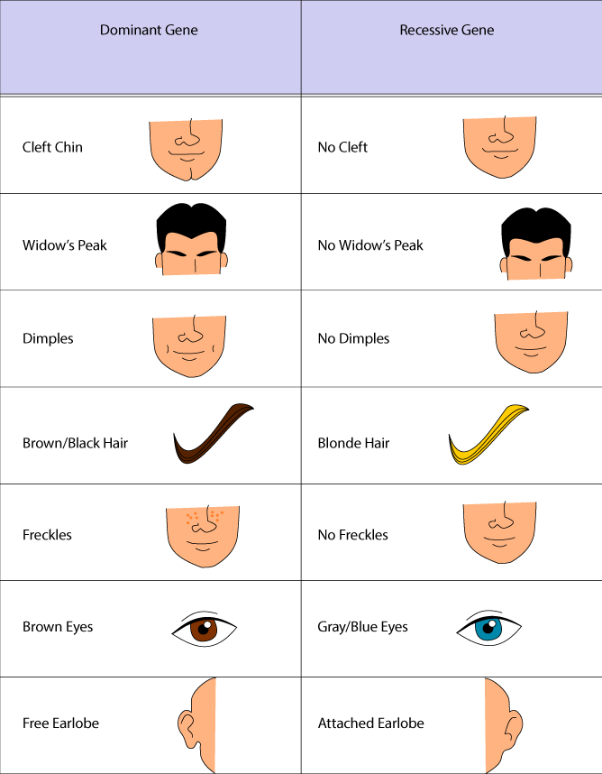
Explain why some traits are more common than others
Have you ever wondered why you may look the same or different from your parents or siblings?
Throughout this unit of work, we will learn about you!
Where did you get your hair colour from?
Why is your eye colour different from your parents?
Can you predict what your child will look like?

Slide 7
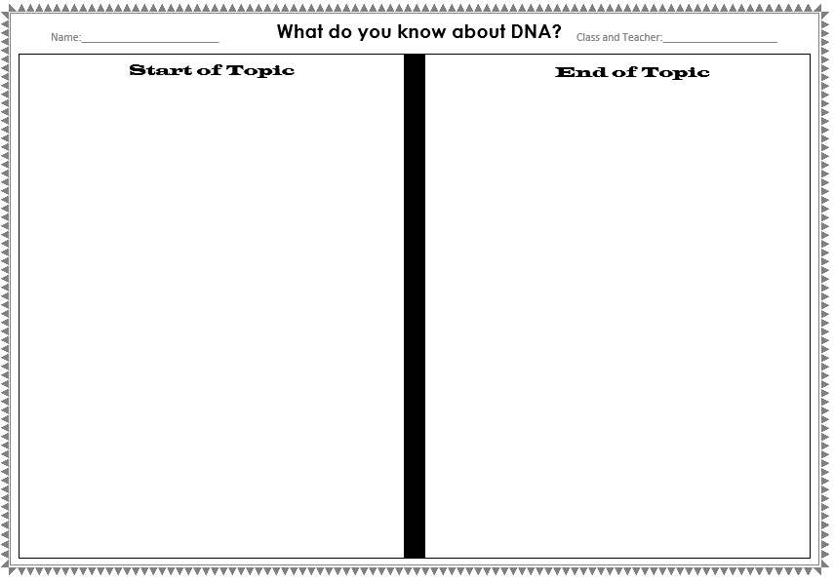
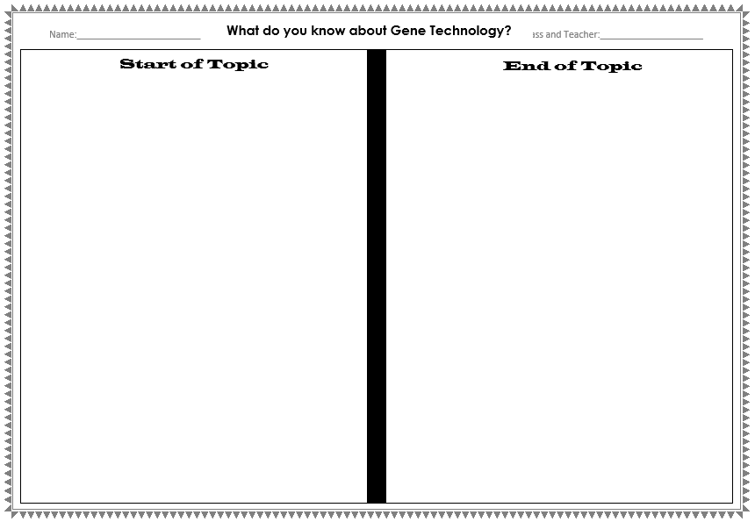
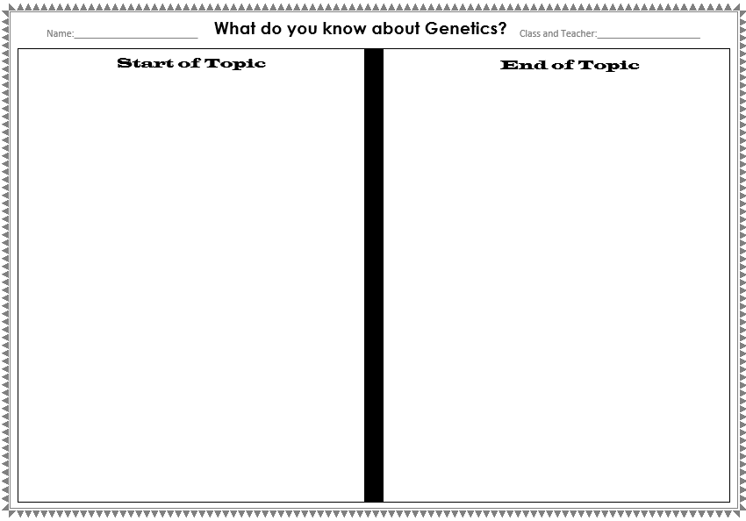
Explain their current knowledge about Genetics
What do you know about DNA and Genetics?
Conceptual Diagnostic Task

Slide 8
What do you know about DNA and Genetics?

Slide 9
What do you know about DNA and Genetics?

Slide 10
What do you know about DNA and Genetics?

Slide 11
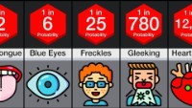

Slide 12
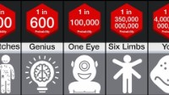

Slide 16
Notes:
Please include tasks/questions here rather than just referring to a worksheet. This will save on photocopying and facilitate sharing with other schools.
Try and build tasks/questions which escalate through Bloom’s Taxonomy. This will help with differentiation.

Slide 17
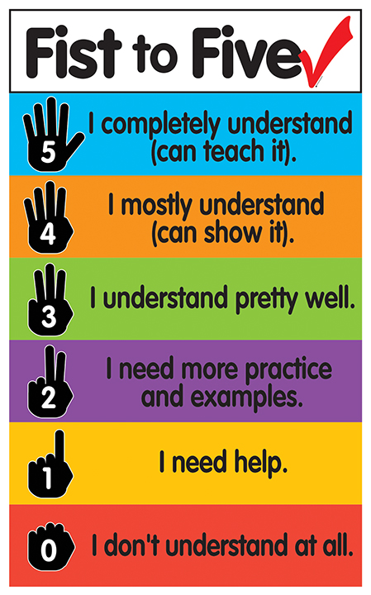
We are learning about: Genetics
TRACK WITH ME
READ WITH ME
Identify their genetic traits
Explain why some traits are more common than others (dominant vs. recessive)
Explain their current knowledge about Genetics
DECLARE THE OBJECTIVE
Read the learning objective to your partner.
Notes:
Learning Objectives contain concepts (nouns, big ideas), skills (verbs, measurable behaviours) and sometimes context (restricting or targeting conditions).
●Example: Students will be able to describe the concept of density and apply it to floating and sinking.
●
Success criteria are specific measurable outcomes that if met mean that the student has met the learning objective.
Examples:
•Students will be able to compare densities of substances using mass and volume.
•Students will be able to identify whether a solid or liquid will float or sink in a liquid based on their densities.

